Slide 1


The Road to Reaffirmation:
Federal Compliance Subcommittees charge
March 2023

Slide 2
HLC Open Pathway—Year 8
Open Pathway
Prepare Assurance Filing
(Years 1-3)
Assurance Review
(Year 4)
Quality Initiative Proposal
(Years 5 -7)
Quality Initiative Report & Prepare Assurance Filing
(Years 7-9)
Comprehensive Evaluation for Reaffirmation & Federal Compliance Filing
(Year 10)
Fall 2024
Spring 2019
Fall 2022-23
Spring 2022

Slide 3
Reaffirmation of Accreditation
Steps to Reaffirmation:
Multilocation Report and Visit
  March 2023
    21st HCOM Athens
    23rd HCOM Cleveland
Quality Initiative Project Final Report
  6/1/2024
Assurance Argument with evidence file
  12/1/2024 Final Draft
Federal Compliance Report
  12/15/2024
HLC Student Opinion Survey
  Two months prior to visit
On-Site Peer Review Visit
  March 24-25th, 2025
Timeline:
December 1, 2024 Final Draft Completed
Fall 2024
  Vet drafts & finalize narrative
  Move to Assurance System
Spring/Summer 2024
  Review drafts & curate evidence
Summer/Fall 2023
  Write Narrative draft
  Organize evidence
May-August 2023
  Fill gaps & implement recommendations
April 2023
  Final Evidence Committees: gaps & recommendations
December 2022
  Evidence requests to units
  Follow up with units not responding to TLA requests

Slide 4
HLC Federal Compliance Subcommittees
Subcommittee 1:
Assignment of credits, program length and tuition
Institutional mechanisms for handling student complaints
Protection of student privacy
Deb Benton Mac Stricklen Ed Carter Kerri Griffin Beth Quitslund | John Day Kari Lehman Laura Myers Connie Patterson

Slide 5
HLC Federal Compliance Subcommittees
Subcommittee 2:
Publication of transfer policies
Practices for verification of student identity
Recruiting, admissions, and related institutional practices
Rob Callahan Mateo Remsburg Ryan Chapman Regina Schwartz Val Miller | Katie Tadlock Jill Nice Candi Morris Ashlee Bevan

Slide 6
HLC Federal Compliance Subcommittees
Subcommittee 3: Outcomes and Accreditation
Publication of student outcome data
Standing with the State and other accreditors
Joni Wadley Loralyn Taylor Melinda Rhodes-DiSalvo Janelle Crossgrove Hart

Slide 7
HLC Federal Compliance Committee
Review policies and procedures related to
  The Assumed Practices
  Specific Federal regulations
Prepare the Federal Compliance Report

Slide 8
Timeline for deliverables
Launch Federal Compliance Committee and subcommittees
Feb/March 2023
Deliverable 1:
Learn about HLC Requirements; Identify OHIO policies
May 2023
Deliverable 5:
Submit Federal Compliance Report 12-15-24
Deliverable 2: Qualitative evaluation of Polices
9/15/2023
Deliverable 3: Recommendations to leadership and responsible parties to improve compliance
10/15/2023
Deliverable 4:
Compile rough draft Report
8/1/2024

Slide 9
Role and Responsibility of HLC Federal Compliance Committee
Review reading and materials prior to meetings
Review policies and procedures related to
  The Assumed Practices
  Specific Federal regulations relevant to your subcommittee
Gather information from campus websites and through solicitation of responsible people or offices
Evaluate evidence for inclusion in final Federal Compliance Report
Capture list of gaps, errors, or omissions as they emerge
Maintain neutral, factual documentation
Maintain confidentiality within this group
Work with co-chairs to seek legal advice as needed
Help prepare the Federal Compliance Report

Slide 10
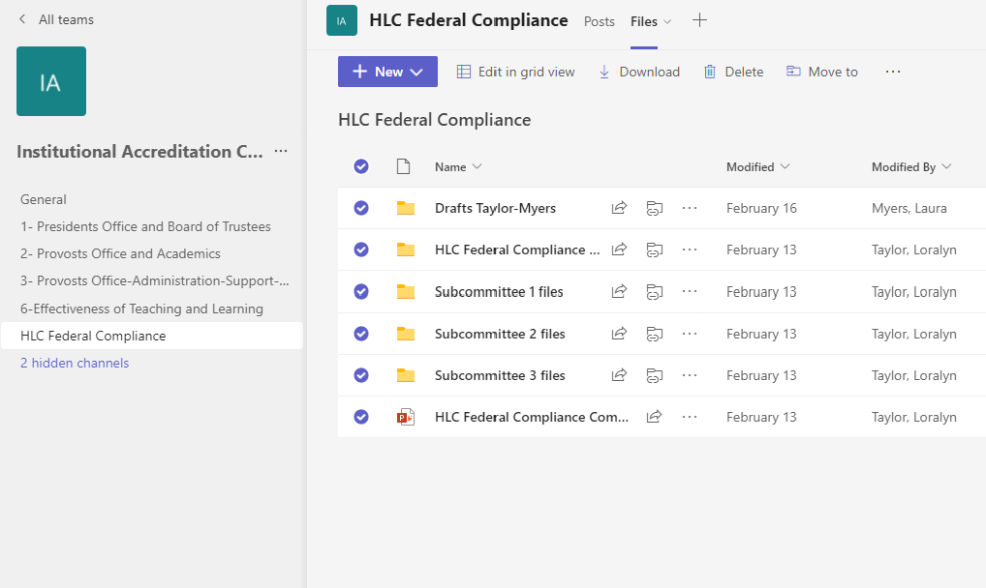

Slide 11
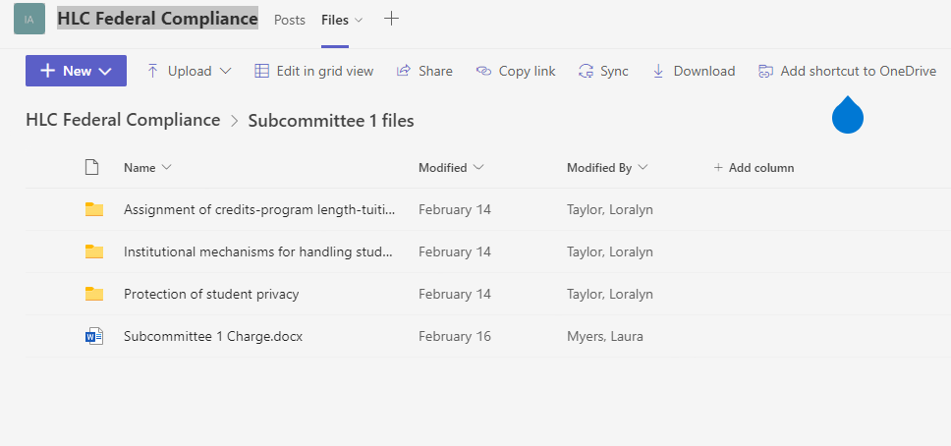


Instructions pt. 1
Go to the folder for the subcommittee to which you were assigned (green)
Read the Subcommittee Charge (red)
Open the folder for the requirement to which you were assigned (blue)

Slide 12
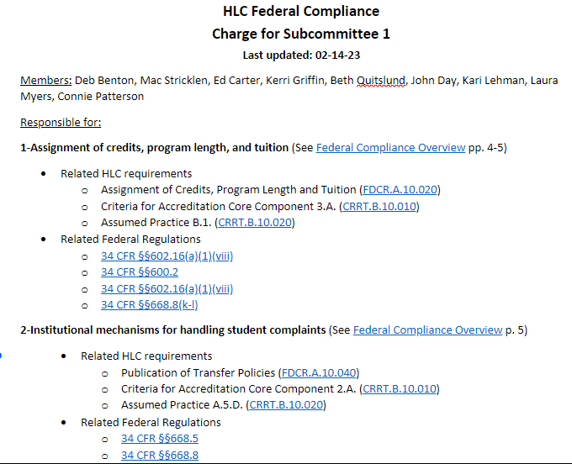
Subcommittee Charge
-membership
-links to policies

Slide 13
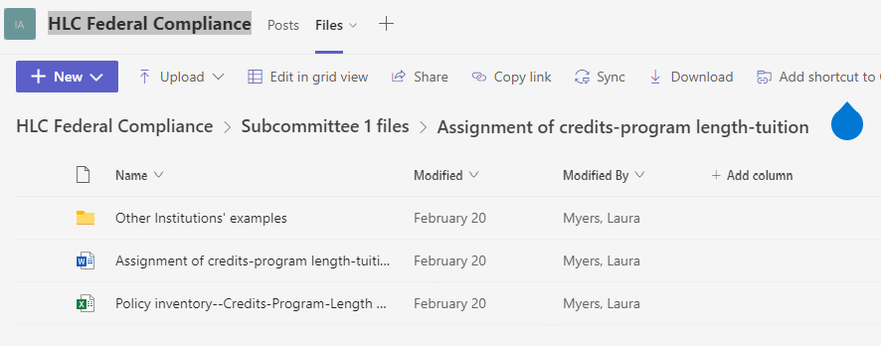
Instructions pt. 2
4) Read the resources document for the requirement (orange)
5) Complete the Policy Inventory spreadsheet (purple)
6) Benchmark Ohio and national peer institutions’ policies and add links or documents to Other Institutions’ examples folder (yellow)

Slide 14
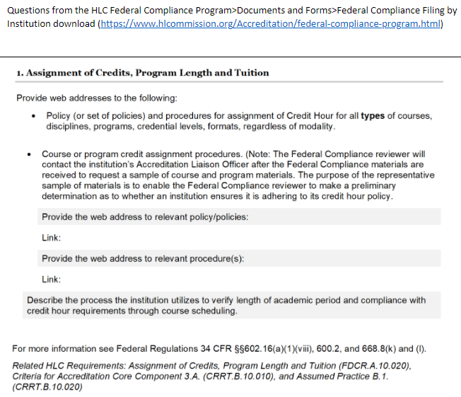
Requirement Folder
-for each Requirement Workgroup
-links to policies
-relevant questions from Compliance filing
-steps to review (next slide)

Slide 15
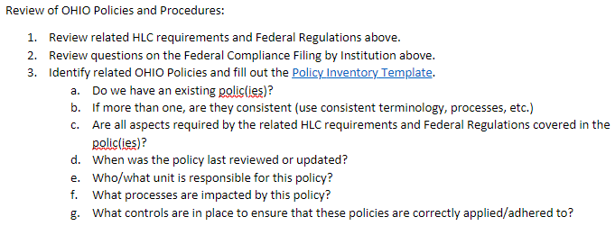
Steps to review

Slide 16
Where do we look?
OHIO "Big P" policies:
University Policy Administrative Policy Manual (ohio.edu/policy)
Faculty Handbook
Other policies, procedures and guidance:
Standing or academic committee procedures
College webpages
OHIO webpages managed by compliance function "owners" such as OIT, HR, Registrar, ECRC, Research and Sponsored Programs, etc.
Benchmarking:
Other institutions (in state and national) ; IUC model documents professional associations and affinity groups

Slide 17
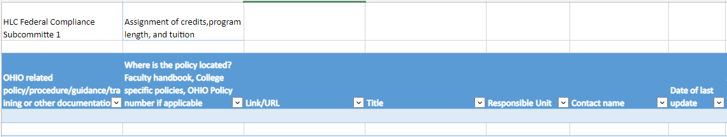
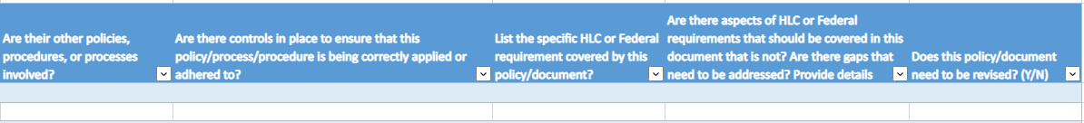
Complete the Policy Inventory

Slide 18
Next Steps:
Assign people to each Requirement Workgroup
  Everyone or subdivide
  At least 2 people per requirement
Set expectations
  Individual reading of required policy or policies
  Then meet and discuss or identify OHIO policies and processes
  Start filling in the Policy Inventory
    Continue individual work on inventory
  THEN
  Benchmark against other institutions—is our policy complete?
  Identify gaps or improvements

Slide 19
Timeline for deliverables
Launch Federal Compliance Committee and subcommittees
Feb/March 2023
Deliverable 1:
Learn about HLC Requirements; Identify OHIO policies
May 2023
Deliverable 5:
Submit Federal Compliance Report 12-15-24
Deliverable 2: Qualitative evaluation of Polices
9/15/2023
Deliverable 3: Recommendations to leadership and responsible parties to improve compliance
10/15/2023
Deliverable 4:
Compile rough draft Report
8/1/2024
May mtg
Requirement Workgroup:
Review & complete policy/process inventory
June/July mtgs
Requirement Workgroup:
Review & complete policy/process inventory
Benchmark against others
Aug mtg
SubCommittee meeting:
Review completed evaluation of policies/process in inventory & gap analysis
September mtg
SubCommittee
meeting:
Finalizing subcommittee report due 9/15

